Slide 1
Manufacturing CS
Update

Slide 2
What have been done
Circuit printing is completed
Maximized nesting is tested
Laboratory manual is in process

Slide 3
Time optimization

Slide 4
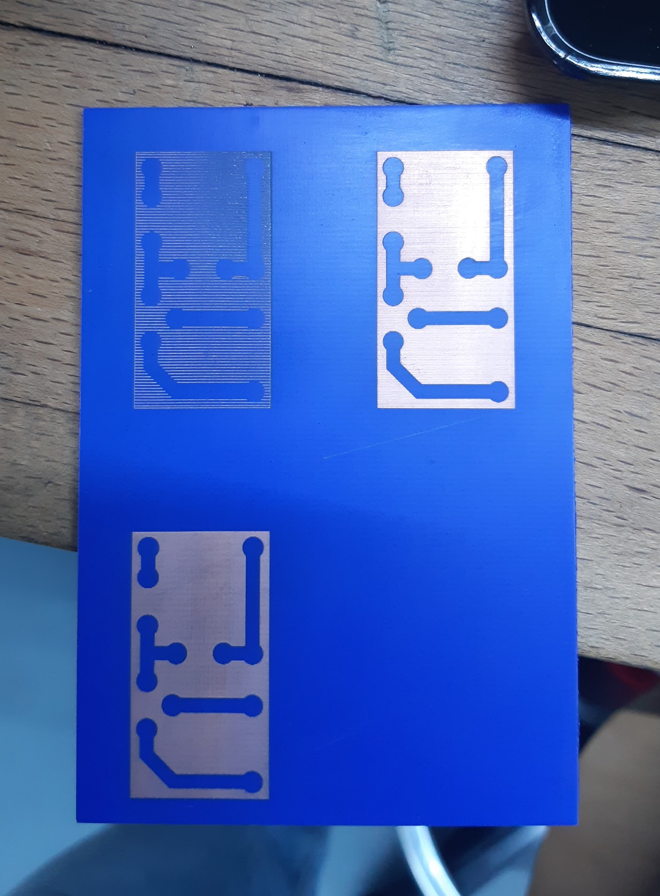
Quality vs
Time process
N/h ~ Time
Lower hatch distance - better quality

Slide 5
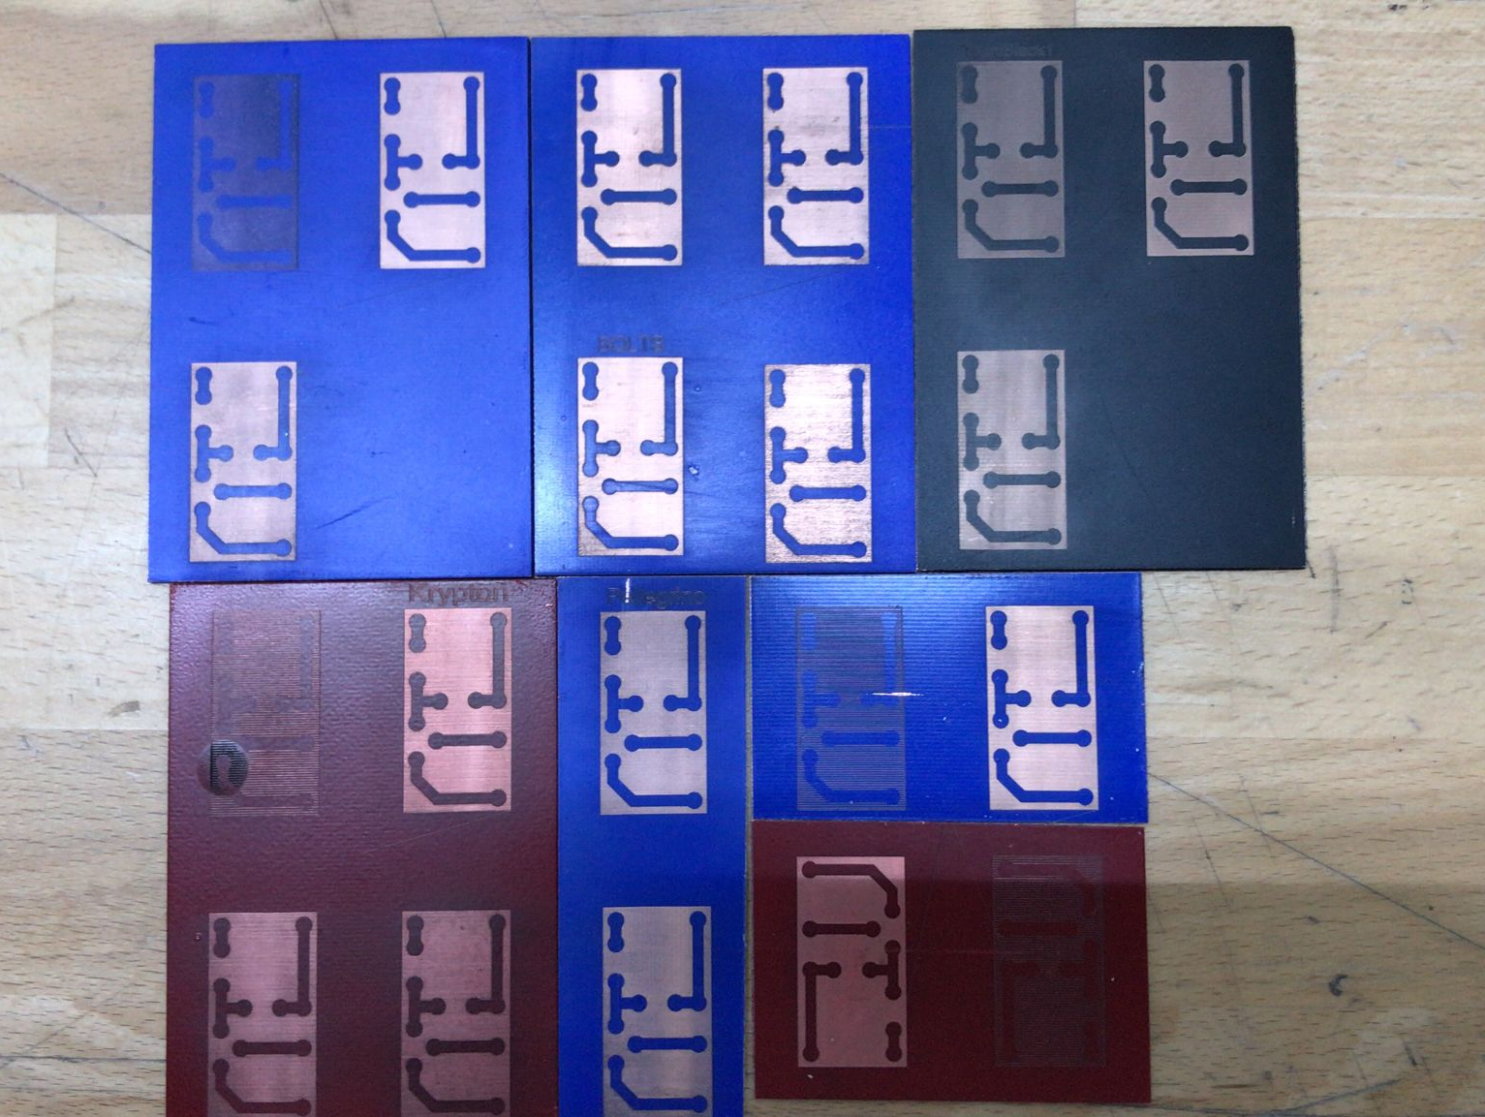

Slide 6
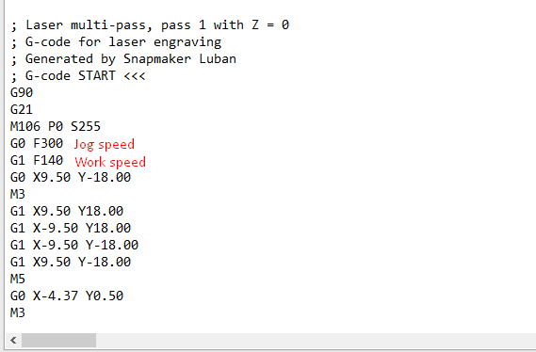
Input parameters error

Slide 7
Maximized Nesting

Slide 8
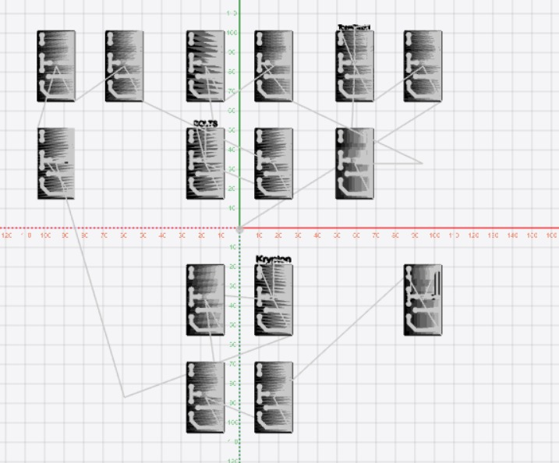
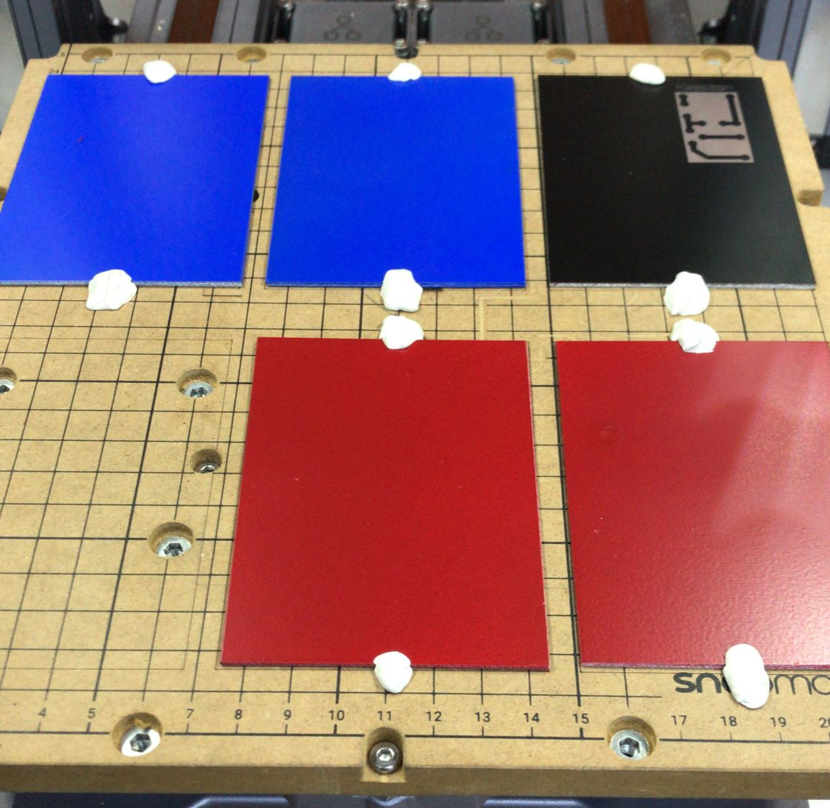
Input
Output

Slide 9
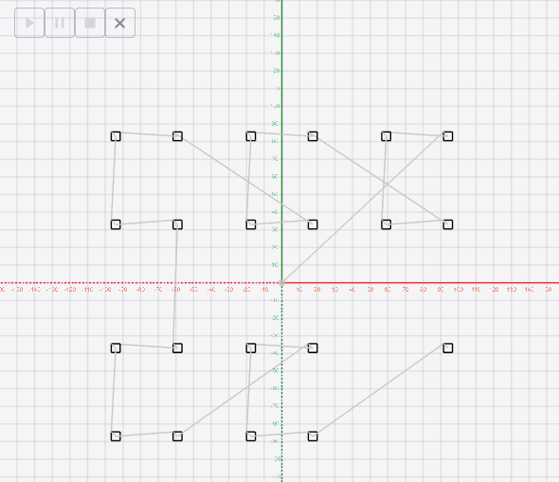
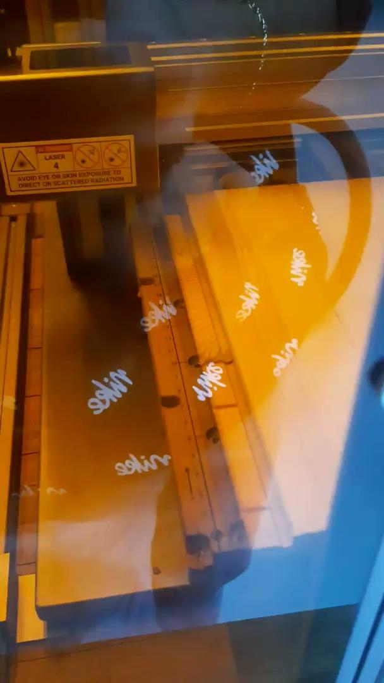
Input
Output

Slide 10

To be continued

Slide 11
Thank you for attention

